Slide 1

Exploring San Francisco Neighborhoods
Through the lens of police incident reports, citizen reported 311 cases, and housing prices from 2018 to 2020

Slide 2

San Francisco: Fast Facts
16th most populous city in the United States
4th most populous city in California
2019: 7th highest income county in the United States¹
2019: GDP of $203.5 Billion¹
Expensive housing prices
¹ Source: Bureau of Economic Analysis (BEA) 2019:
https://www.bea.gov/data/income-saving/personal-income-county-metro-and-other-areas

Slide 3


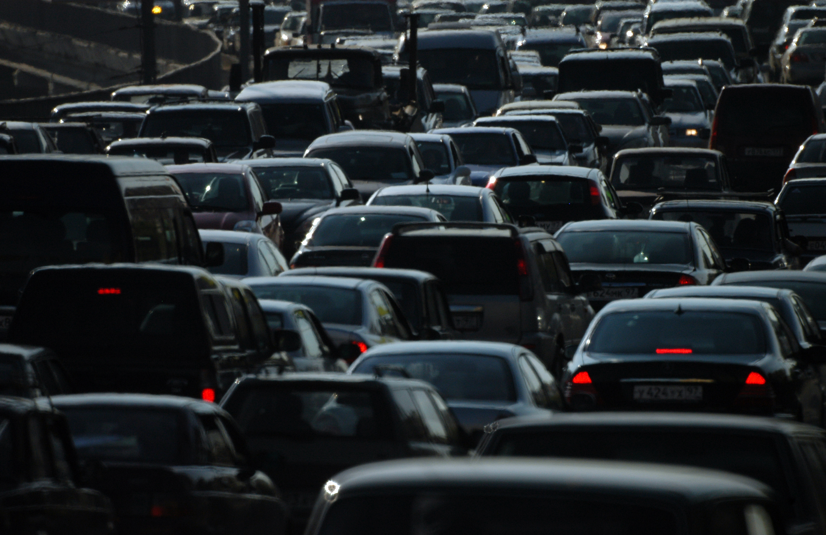


Growing City, Growing Problems
Crime
Vehicle break-ins
Homeless Encampments
High Housing Prices

Slide 4



Data Sources
San Francisco Police Department Incident Reports: 2018 to Present | DataSF | City and County of San Francisco
311 Cases | DataSF | City and County of San Francisco
Redfin’s Downloadable Housing Market Data median housing sales prices

Slide 5

Seeking answers to…
Can we predict housing prices from features derived from the police incident reports and 311 cases?
How do the neighborhoods differ from one another?

Slide 6
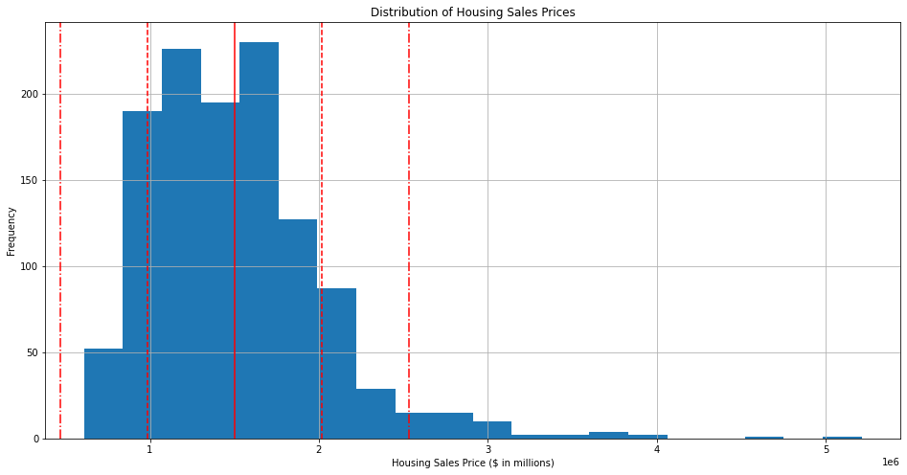

Slide 7
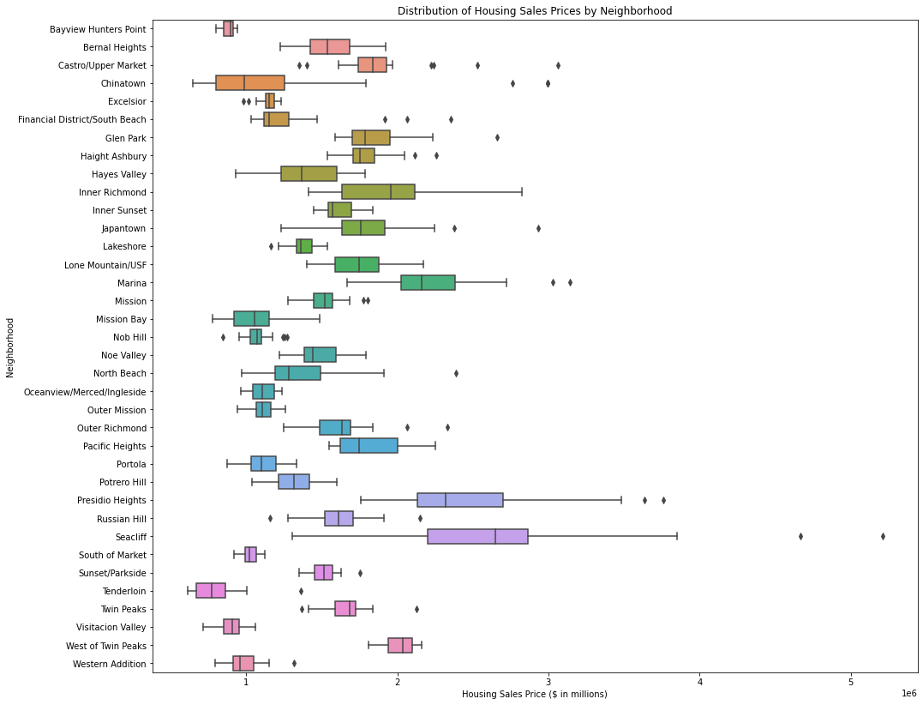

Slide 8
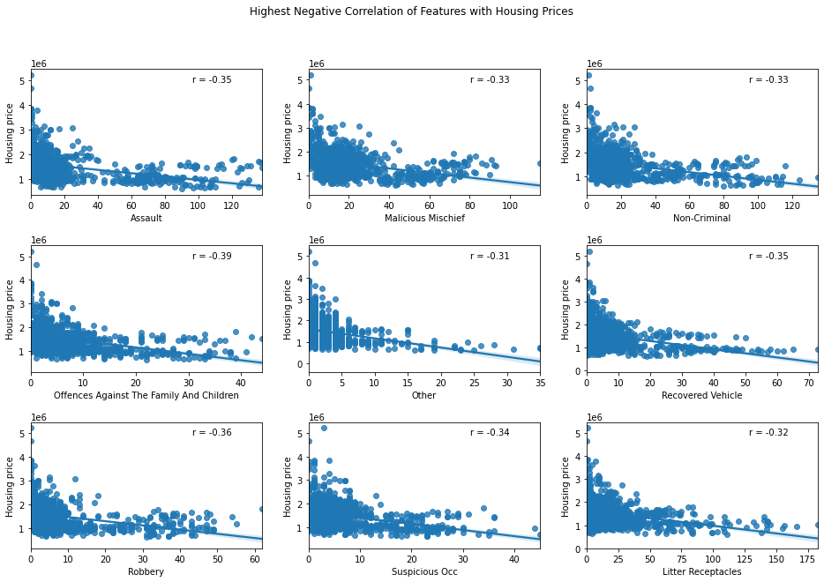

Slide 9


Modeling – Predicting Housing Prices
Best Model after using GridSearchCV to tune hyperparameters:
Min Max Scaler
PCA, n_components = 7
Random Forest Regressor, max_depth = 10, n_estimator = 31
R-squared = 0.349708
Mean Absolute Error (MAE): $247,694.77
Sqrt(Mean Squared Error): $365,848.02

Slide 10
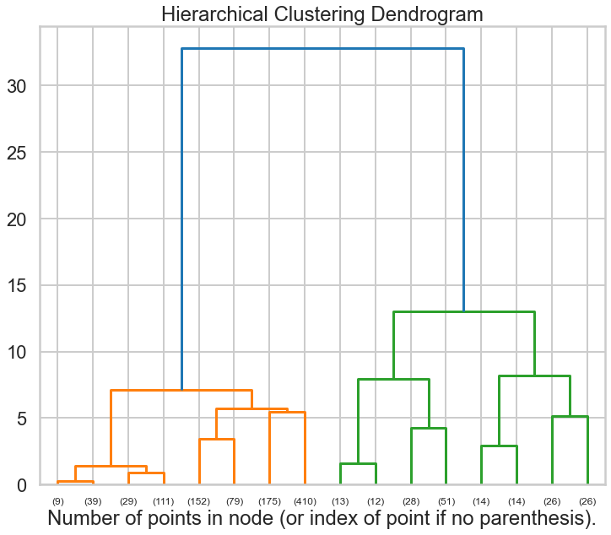
Modeling – Clustering Neighborhoods

Slide 11
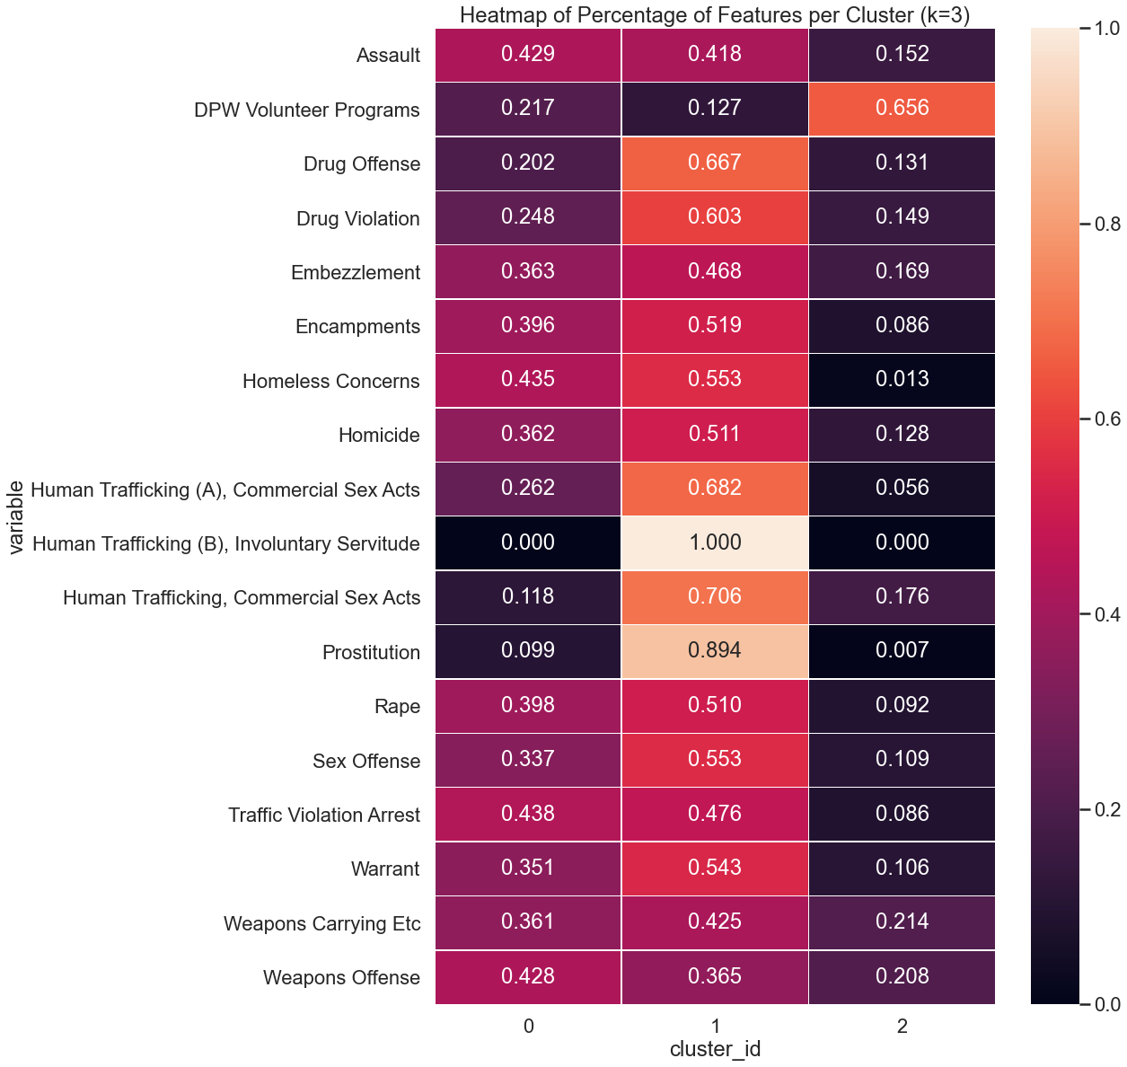
Features of neighborhoods in clusters
K-Means with n_clusters = 3
Cluster_id = 0 : default catch-all
Cluster_id = 1 : violent crimes
Cluster_id = 2 : DPW Volunteer Programs and nearly no Encampments or Homeless Concerns

Slide 12
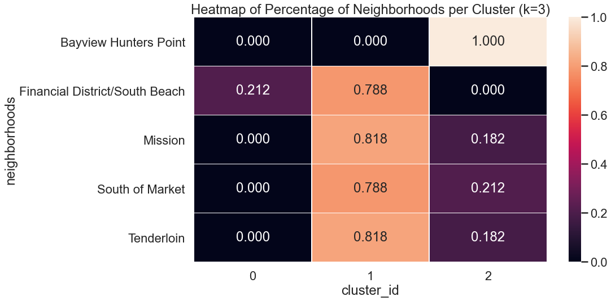

Slide 13
Further Research
Increase time frame of data
1
Improve model – clustering : increase granularity of police incident and 311 case data
2
Improve model – predicting housing prices : add property data
3

